Slide 1
Introduction (material updated)
Some back ground info:
I am building a race car that I designed myself (I know, cliché). There is lot of info about it here if you care to learn.
This project is the Vehicle Control Unit (VCU) which is a supplementary controller to the stock motorcycle Engine Control Unit which I have already got working with the engine (e.g. I can start, idle, and rev up the engine). I will source the PCBs for manufacture.
I am a mechanical engineer (feel free to connect with me in LinkedIn). I work in software and controls for hybrid electric vehicle powertrains for commercial vehicles. I know almost nothing about electrical engineering or PCB design, so this is all very new to me. Any help, guidance, etc. is very much appreciated.
Project Summary and some details.
The project is to design two PCBs: PCB_SHIELD and PCB_POWER per the schematic and supplemental requirements provided here in.
The PCBs shall be design in KiCad (latest version), and all source files will be provided at the end.
The project includes making or finding all footprints, and eeschma library models for each component.
I intend to pick up the KiCad development after this initial setup of the VCU PCBs design, hence why I need the KiCad source files delivered. I tried, but, starting from zero was just too much for me.
The PCBs are mounted to opposing sides of an enclosure.
All components are purchased from mouser.ca
As you can see, I have done some preliminary packaging studies to ensure there is reasonable available space. The layouts shown are mostly for example, but I have clearly identified components for which the location is fixed (if really needed, it they could be moved, but some discussion would be required). I am happy to work together for packaging if the CAD models I have will help. Any additional views, or annotated drawings with dimensions can be made.
As you can see, I have made pin assignments for the Raspberry Pi. I believe this assignment scheme will work for me, but I am very open to suggestions for improvement.
The VCU functions are:
Read switches and sensors from various areas of the car
Driver switches
Suspension position
Wheel speed sensors
MEMS 6DOF acceleration and gyro
Actuate a solenoid which push/pulls the engine shift lever to change gears up and down (the solenoid is design and sold by Pingel for shifting the bike engine, so it’ll work)
Actuate a permanent magnet 1.5kW automotive starter motor. The engagement solenoid and motor stator are driven separately. Lots of current in the motor stator. Since a bike engine has no reverse gear, this motor is used to drive the car in reverse.
Control the precharging of the large capacitor. The capacitor is used for damping voltage oscillations from PWM control of motor stator
Control N mostfet used for breaking the 12VDC circuit used by Engine Control Unit to trigger spark. The 4 cylinders have coil over plugs, and all 4 coils share a common ground. The ground will be broken by the N mosfet.

Slide 2
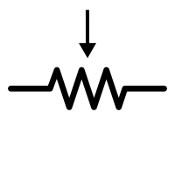
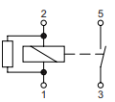
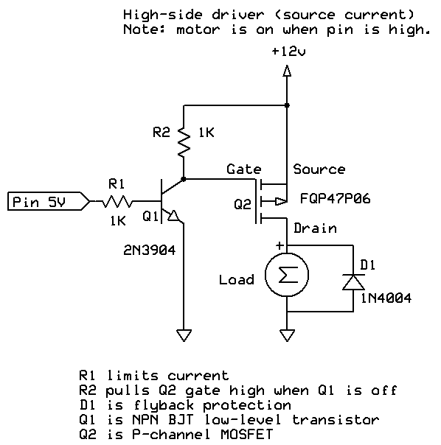
Pin # ?
Raspberry Pi 3 B+
Pinout uses Physical pin numbers from: https://pinout.xyz/pinout/pin32_gpio12
Unassigned GPIO:
12
26
27
38
40
Parts list
Whl spd sensor interface chip: https://www.mouser.ca/ProductDetail/863-NCV1124DR2G
R1: whl sensor series resistor: 15kOhm. https://www.mouser.ca/ProductDetail/?qs=LCMWAU1DZcyQzYgWWU5IFA%3d%3d
Radj: whl sensor adjustment resistor: 16.9kOhm. https://www.mouser.ca/ProductDetail/Vishay-Dale/CCF5516K9FKE36?qs=sGAEpiMZZMtlubZbdhIBIK%2fmTSw8IDwvWHOMDZccZRU%3d
C1: whl sensor input noise filter. 0.047uF and >120VAC. https://www.mouser.ca/ProductDetail/KEMET/R463F247000N0K?qs=sGAEpiMZZMsh%252b1woXyUXj9ece4xm99ovEOkuJWF0%252b00%3d
P: P channel mosfet: https://www.mouser.ca/ProductDetail/512-FQP47P06
B: BJT for driving the P channels: https://www.mouser.ca/ProductDetail/610-2N3904
N: N channel mosfet: https://www.mouser.ca/ProductDetail/511-STP165N10F4
D: Schottky Diodes: https://www.mouser.ca/ProductDetail/863-MBR60H100CTG
C9: large capacitor: https://www.mouser.ca/ProductDetail/Panasonic/EEU-FP1E202?qs=sGAEpiMZZMsh%252B1woXyUXj3Q6FWM8D%252BEZb5k3ed78Z20%3D
R9: precharge resistor: https://www.mouser.ca/ProductDetail/ARCOL-Ohmite/AP851-1R-F?qs=sGAEpiMZZMtlubZbdhIBIFhE7El7h4X1RcvVOpawzHc%3D
10K: resistor: https://www.mouser.ca/ProductDetail/660-MOS1CT52A103J
50K: resistor: similar to 10K
DCDC: https://www.mouser.ca/ProductDetail/?qs=ckJk83FOD0WLTTuzupq9YA%3d%3d
PR: https://www.mouser.ca/ProductDetail/571-1393315-2
PCR: https://www.mouser.ca/ProductDetail/TE-Connectivity-OEG/1721081-5?qs=sGAEpiMZZMs3UE%252BXNiFaVATggAqWrzPd%252Bs0m51A5JiM%3D
reverse throttle pot: https://www.mouser.ca/ProductDetail/Piher/PT15RV18-103A1010E-S?qs=sGAEpiMZZMtC25l1F4XBU6Tn%252bZ5GAJOxaGLdC0C3qmsG%2fZ55cySTgA%3d%3d
Bellcrank position pot: https://www.mouser.ca/ProductDetail/Piher/PT15RV18-103A1010E-S?qs=sGAEpiMZZMtC25l1F4XBU6Tn%252bZ5GAJOxaGLdC0C3qmsG%2fZ55cySTgA%3d%3d
RL: potentiometer voltage divider: data sheet says RL = 100xRpot(10kOhm) = 1MOhm. https://www.mouser.ca/ProductDetail/Vishay-BC-Components/VR37000001004FR500?qs=sGAEpiMZZMtlubZbdhIBIL6aF40j1MfhZigr1U8glrc%3d
CL: potentiometer voltage divider noise filter: Fc=100Hz. 1/(2pi*100*R1) = 1.6pF. https://www.mouser.ca/ProductDetail/TDK/FA18C0G1H1R5CNU00?qs=sGAEpiMZZMt3KoXD5rJ2N29dp4N5a5oW2jRCkGZEmfI5%252bqimiAbaag%3d%3d
MPC3008: https://www.mouser.ca/ProductDetail/579-MCP3008-I-P
MPU6050: https://www.ebay.ca/i/263276533490?chn=ps&mkevt=1&mkrid=706-89093-2056-0&mkcid=2&dispItem=1
Upshift switch
pin11
Pin # ?
downshift switch
pin13
Pin # ?
reverse switch
pin15
Pin # ?
Spare GPIO: pin8
pin8
Pin # ?
Spare GPIO: pin10
pin10
Pin # ?
Spare GPIO: pin28
pin28
Pin # ?
Spare analog in 1
Pin # ?
Spare analog in 2
Pin # ?
RL
Pin9 GND
Pin # ?
CL
Pin # ?
reverse throttle pot
RL
Pin # ?
CL
Connection between PCB_POWER and PCB_SHIELD.
Header on each board: 12 pin TE Connectivity 3-1445050-2: https://www.mouser.ca/ProductDetail/TE-Connectivity-AMP/3-1445050-2?qs=sGAEpiMZZMuzXLcWrSfMr%252BPRuh9VCiHXHYdP5f2z%252BRs%3D
FL bell crank pot
CH0
Vdd
Pin17 3V3
RL
CH1
Vref
0.130” Dia. Through hole for ring terminal connection on Power PCB:
“Batt_Neg”
CL
MCP3008
PCB_POWER
Pin # ?
CH2
AGND
12V, 1.5A
Batt_Neg
FR bell crank pot
CH3
CLK
pin23
0.130” Dia. Through hole for ring terminal connection on Power PCB:
“Shift_Up”
RL
CH4
Dout
pin21
60A, ~100-200ms
Duty Cycle: 1Hz for 5 sec.
Pin # ?
CL
CH5
Din
pin19
RL bell crank pot
CH6
CS
pin24
pin31
N
D
0.130” Dia. Through hole for ring terminal connection on Power PCB:
“Shift_Down”
RL
CH7
DGND
Pin # ?
CL
pin29
N
D
RR bell crank pot
Pin # ?
Pin25 GND
60A, ~100-200ms
Duty Cycle: 1Hz for 5 sec.
Shift Solenoid
Spark low voltage common ground
N
Pin # ?
Spark kill
pin16
Pin # ?
pin37
C9
Pin # ?
Spare GPIO: pin7
pin7
10k
50k
RS-FL
Radj
8:Vcc
7:OUT1
6:OUT2
5:diag
SWITCHED_12VDC
Whl spd sensor, 4x
R1
12V, 1.5A
Pin # ?
C1
pin22
DCDC
RS-FR
R1
pin18
6
2
1
10k
10k
0.210” Dia. Through hole for ring terminal connection on Power PCB:
“Sw_Pos”
RS-RL
Pin # ?
C1
Radj
1: INadj
2:IN1
3:IN2
4:GND
P
0.050” Dia. Through hole for soldering wire to Power PCB:
“PR_Coil”
Should be located physically near to PR pin 1.
Pin # ?
R1
8:Vcc
7:OUT1
6:OUT2
5:diag
5
4
3
RS-RR
C1
pin35
Pin6 GND
B
0.130” Dia. Through hole for ring terminal connection on Power PCB:
“Key_Sw”
R1
pin36
5VDC Ground
D
Pin # ?
C1
Whl spd sensor interface chip, 2x
Pin2(5V)
5VDC, 3A max
3x P mosfet in parallel
Pin # ?
1: INadj
2:IN1
3:IN2
4:GND
Pin34 GND
10k
pin33
10k
B
B
B
P
P
P
INT
pin32
N
PR
ADD
PCR
MPU6050
100M
A1
11
14
24 pin, 2 row header for PCB_SHIELD.
Pin assignments can be whatever is convenient for PCB layout.
TE Connectivity 5-794618-4
https://www.mouser.ca/ProductDetail/571-5-794618-4
XCL
pin3
3x BJT in parallel
XDA
pin5
D
D
R9
A2
SDA
Pin17 3V3
20A, ~10s
Duty Cycle:. Once every 5min
0.130” Dia. Through hole for ring terminal connection on Power PCB:
“Bat_Pos”
SCI
2x diode in parallel
GND
125A, ~10s
Duty Cycle:
Once every 5min
PCB_SHIELD
Vcc
Description:
The schematic shows controller and data acquisition system for a custom car.
It made of 2 custom PCBs (PCB_SHIELD, PCB_POWER), a STM Discovery board, and various electronics components.
The functions are:
Control switching for solenoid used for shifting gears on a motor cycle engine
Control switching for solenoid and motor of a 1.5kW permanent magnet starter motor, used for driving in reverse.
Solenoid is on/off. Motor is PWM control for voltage modulation.
Control switching for engine spark kill.
Read 4 wheel speed sensors
Read various potentiometers for position sensing
Read various switches for user input.
Broadcast data on CAN network
The system has been split on to 2 PCBs for packaging reasons. I also though it might be a good idea to segregate the high and low power portions. So PCB_SHIELD is a shield for the STM discovery, and PCB_POWER is sort of a power electronics board.
These connections will be made by running wires
Some are shown by dotted lines. Place components so wise can be run without difficulty
0.210” Dia. Through hole for ring terminal connection on Power PCB:
“Mot_Ctrl”
motor
0.130” Dia. Through hole for ring terminal connection on Power PCB:
“Mot_Relay_Ctrl”
12V battery

Slide 3
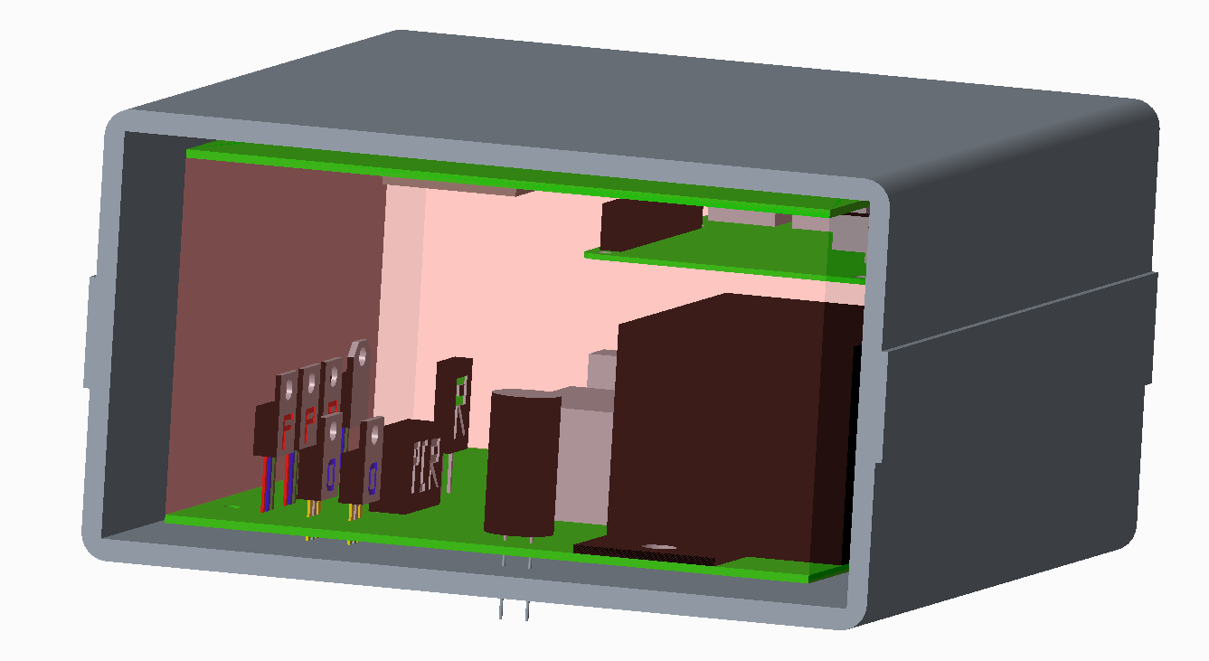
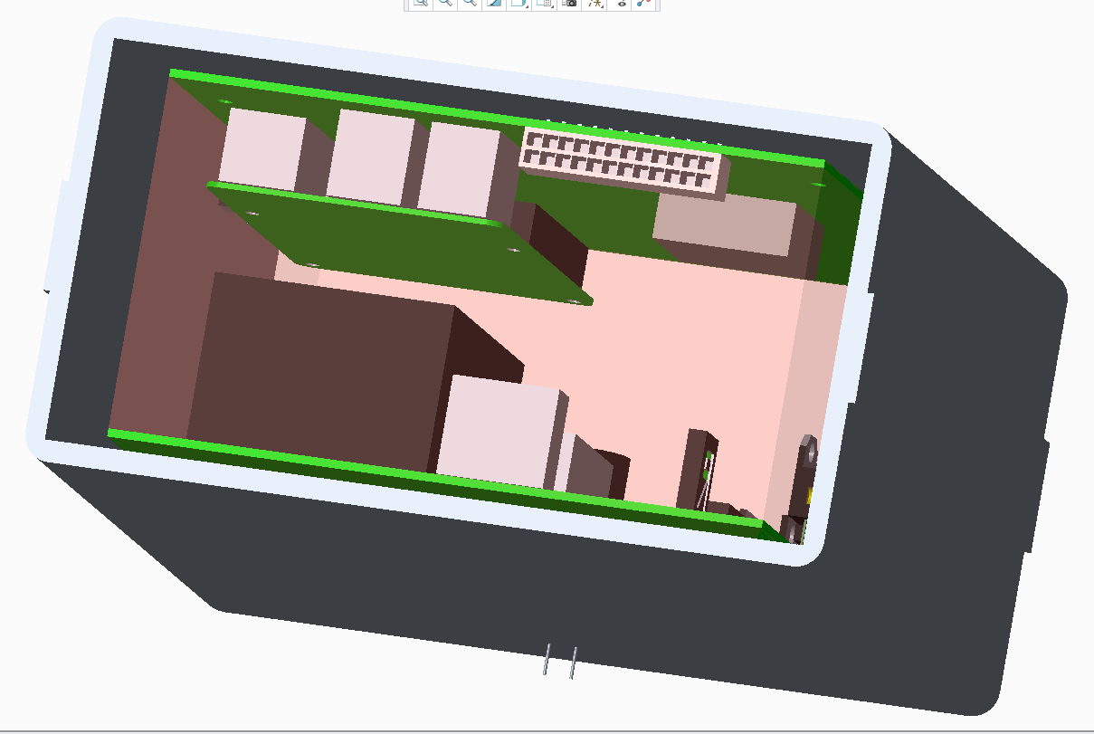
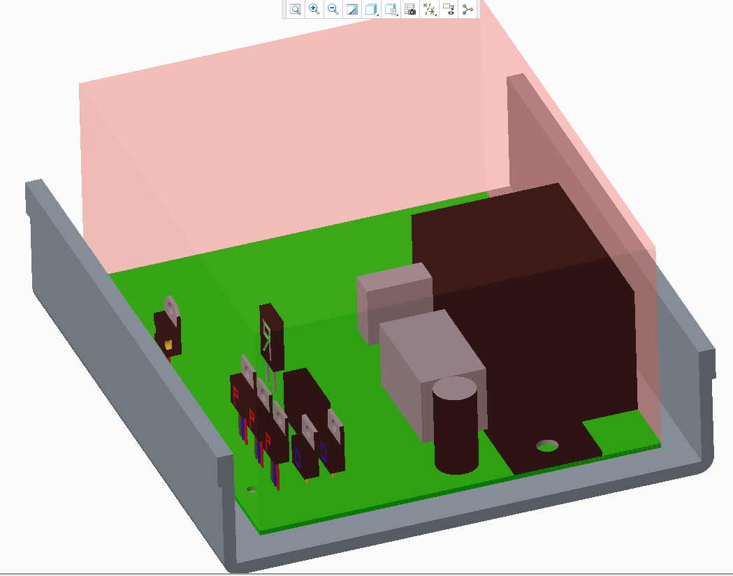
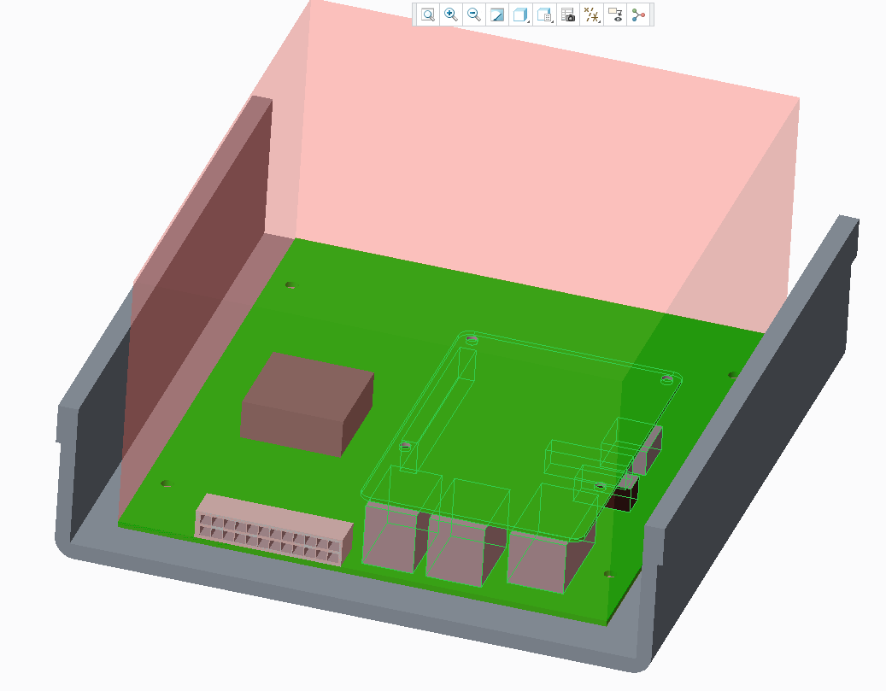

Slide 4
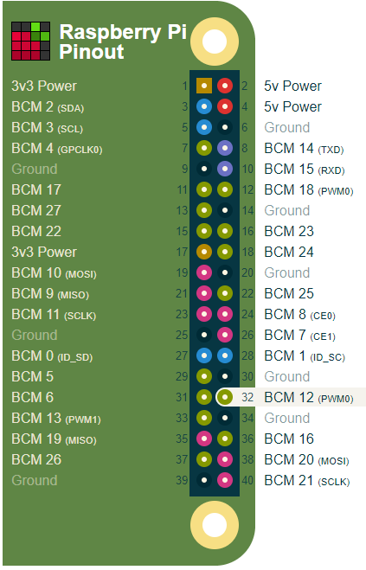
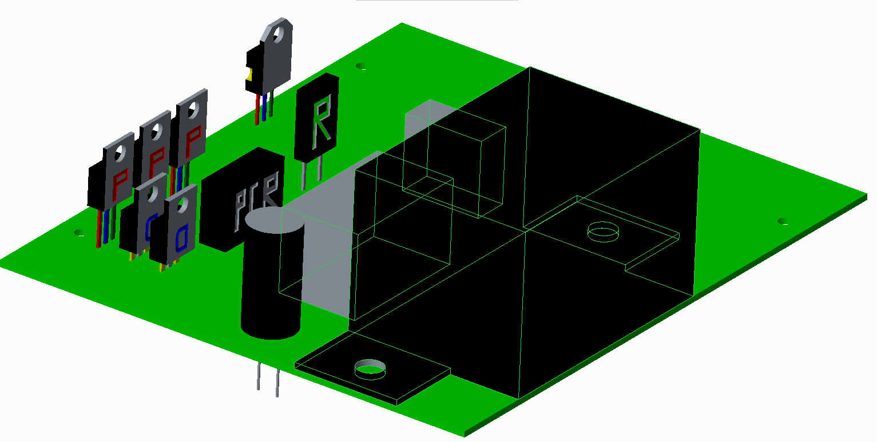
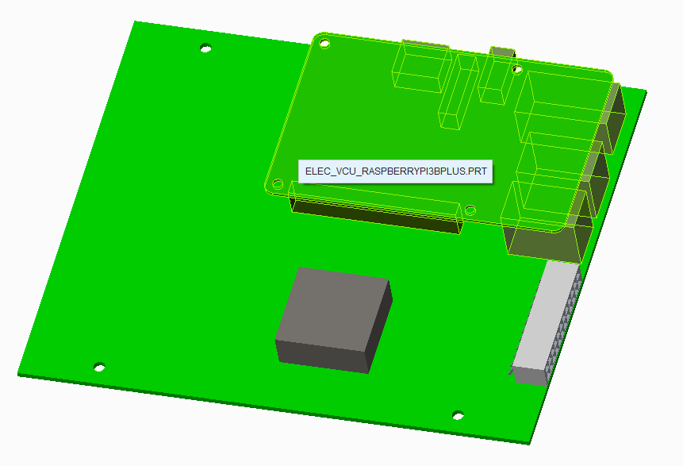
PCB_POWER showing:
Power relay
Precharge relay
Precharge resistor
Large capacitor
Motor drive P mostfets
Motor dive diodes
N mosfet for driving power relay
Many components missing, but looks like there might be enough space for them.
PCB_SHIELD
Showing Raspberry Pi, DCDC, sensors header
Many components missing, but looks like there might be enough space for them
Some info about open source Pi hats here: https://forum.kicad.info/t/raspberry-pi-b-hat-template/738/24
I need the PI here to have access to the
usb ports when the enclosure is closed.
The location of the power relay is fixed,
unless there is a really good reason to move it.
I need the header here to exit the enclosure.

Slide 5
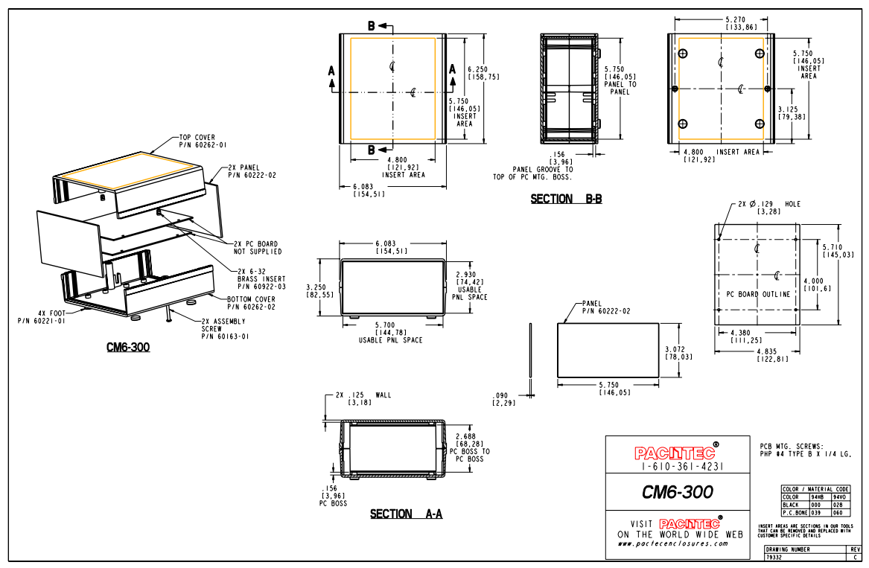
PCB outline and mounting holes.

Slide 6
Questions (a.k.a. things I already think I got wrong):
Are the currents for the motor control line too much? Most feedback I have says its possible to run traces as wide as 20mm, and using 4oz cu board. I also want these traces as short as possible between the Sw_Pos > MOSFETs > Mot_Ctrl locations on the board. Wide traces, with 4oz, and short distance, should minimize the heat.
Alternative mosfet option: IXTQ52P10P https://www.mouser.ca/ProductDetail/IXYS/IXTQ52P10P?qs=%2Fha2pyFaduixTMZlipwWchWWhpK5SNJlZtYhrRFn30lrILdCdkcKwQ%3D%3D
do i really need the 3 parallel BJTs to run the 3 parallel P mosfets? Most feedback I have is that either one BJT, one smaller N mosfet, or one opto-coupler should work for running these 3 large P mosfets. I accept any solution provided it is done with adequate extra space around that area, so that if the solution doesn't work well, I can change the KiCad project files my self, to try something else.
Opto-coupler option: pc817 https://www.mouser.ca/ProductDetail/Sharp-Microelectronics/PC817XNNSZ1B?qs=sGAEpiMZZMteimceiIVCBwOhTfXkD2DS1XBwbcKwuGswjhyO3oyW1w%3D%3D
DCDC pin 4 is for trimming, and looking at the “thn15wi-voltage-adjustment.pdf”, if I want 5V, then I want infinite resistance. I have shown a 100MOhm resistor there. My intent with that is to have the option of leaving the pin floating, or putting in a large resistor.
I cannot seem to avoid having the 12VDC ground connected to components that are also connected to Pi, is that OK?
I included a voltage divider on the SWITCHED_12VDC node so the Pi could measure the voltage of that node. Will that work given that the Pi doesn’t have access to 12VDC ground directly? Should or could the Pi have access to the 12VDC ground? If so, how should I do that?
The MCP3008 and MPU6050 likely need to be connected to the board using base that it soldered to the board, and the chip is pressed into. I suspect that soldering to the chip could overheat or damage it in some way. I am not confident this is true.

Slide 7
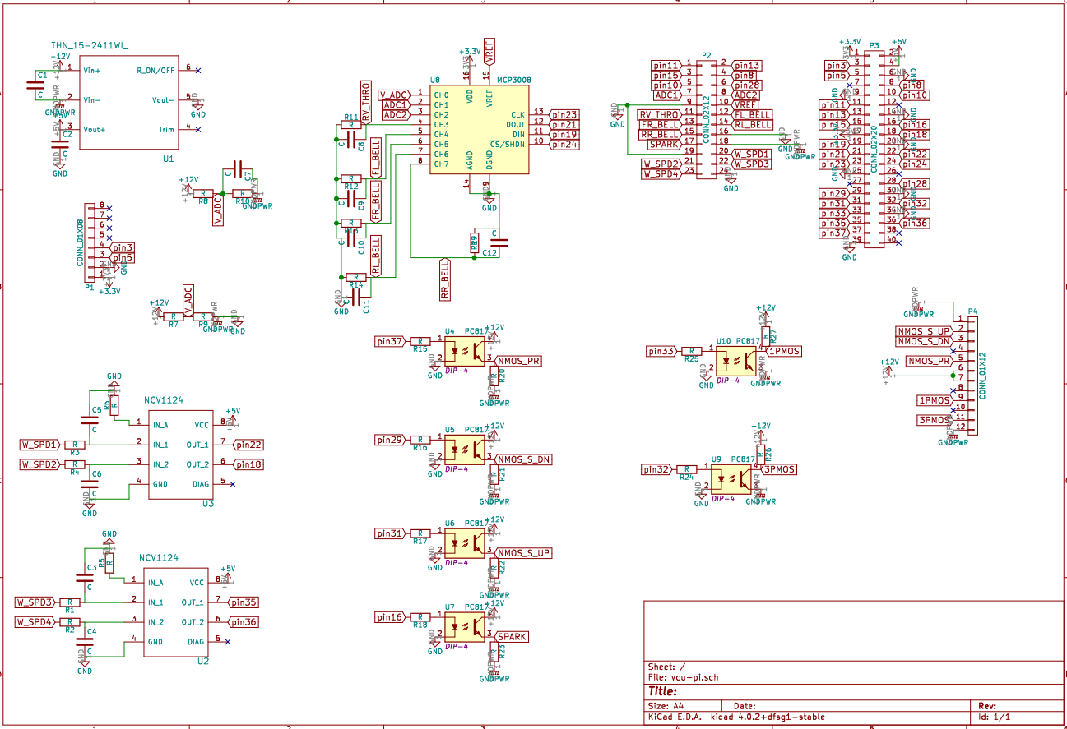
I would like to have the option of connecting pin4 to resistor, then to GND as shown in schematic. I wont put a resistor at first since that should work., but if it doesn't, then I have option to but resistor easily.
Review of sche.pdf 2019-03-19.
My schematic shows pin7 connected to P2 as “Spare GPIO” at 19 on P2
My schematic shows pin7 connected to P2 as “Spare GPIO”
Why add capacitor between pin1 and pin 2?
Why add capacitor between pin3 and pin 5?
These look like the same, but one has capacitor. Why do we need both?
Why use 2 pins for 12V, but then only 1 pin for GNDPWR, they will have the same current flowing.

Slide 8
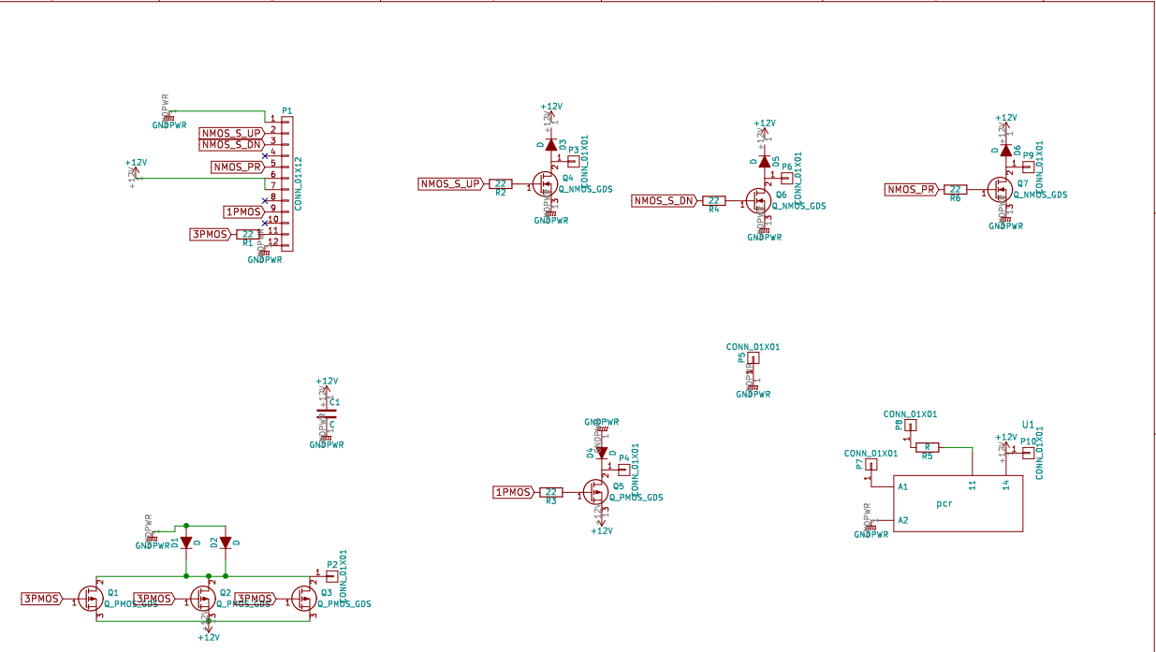
Review of output.pdf 2019-03-19.
I have placed comments about labels. I want these labels on the PCB, so maybe they do not need to appear in the schematic, but I like everything to have consistent naming, so if it’s possible, I’d like to do that here.
Can we add a label on this? “S_UP”
Can we add a label on this? “S_DN”
Can we add a label on this? “PR_Coil”
Why use 2 pins for 12V, but then only 1 pin for GNDPWR, they will have the same current flowing.
Can we add a label on this? “Bat_Neg”
Can we add a label on this? “Bat_Pos”
Can we add a label on this? “Mot_Rly_Ctrl”
Can we add a label on this? “Sw_Pos”
Can we add a label on this? “Key_Sw”
Can we add a label on this? “Mot_Ctrl”
Why show Source at bottom, and Drain at top?
Why show Source at bottom, and Drain at top?

Slide 9
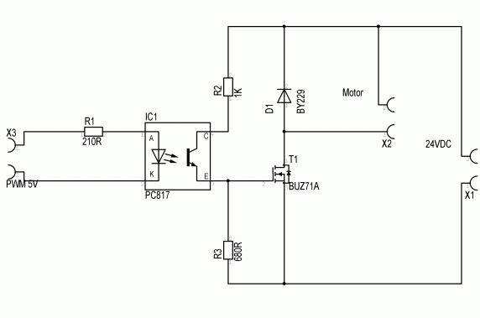
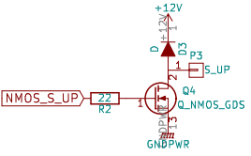
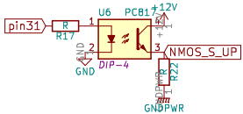
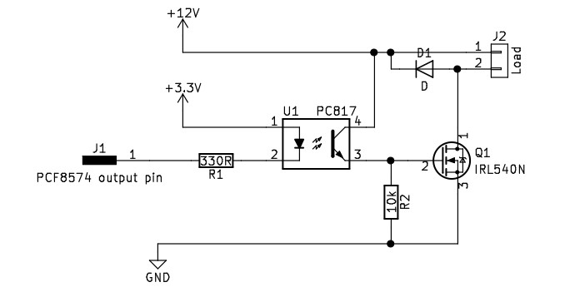
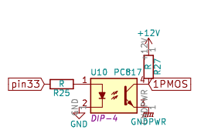
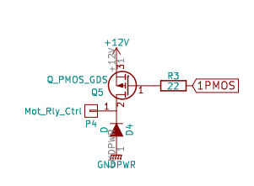
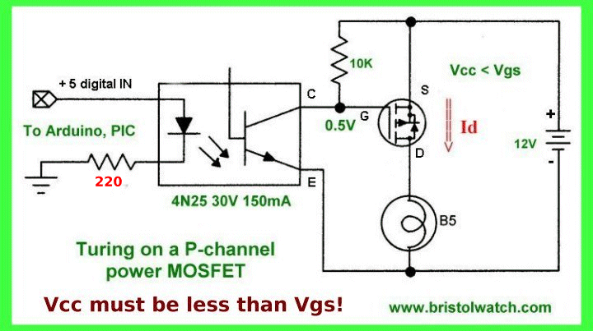
Review of Driving MOSFET with opto-coupler
N mosfet: https://electronics.stackexchange.com/questions/17116/how-to-drive-a-mosfet-with-an-optocoupler
I had selected N mosfets that are logic level, so I think they cannot be driven by opto-coupler switching 12V
The N mosfet have Vgs(th) min=2V , and max=4V, so I think we need a resistor between opto-coupler pinC, and 12V as shown here.
Using the web schematic as example, I think we need a R2=3*R3, so that we get between 2V and 4V as 12V battery is between 8V and 16V.
The 12V battery will only actually go between 10V and 14.5V, so the mosfet drive voltage will be in tolerance.
I see you have added R2 between opto-coupler pinE and mosfet gate, why is that? Please do not remove it, im just curious.
Can we add a resistor between opto-coupler pinC and 12V, so that we can make a voltage divider here if necessary?
We can just short that connection if voltage divider not needed.
Sorry, My knowledge of this stuff is very little, so I’m making mistakes, and learning as we go.
N mosfet: https://electronics.stackexchange.com/questions/294744/mosfet-switch-using-an-optocoupler
Also, we are using the PI GPIO as hi side driver for opto-coupler control. I need to check if that is ok.
https://rpi.science.uoit.ca/lab/gpio/, that says “The GPIO pins are connected to the +3.3V rails. When used for input they are able to read voltages. When used for output they may be set to +3.3V (high) or 0V (low).”, so I think it is ok.
The link above is a schematic showing a low side driver configuration →
P mosfet:http://www.bristolwatch.com/ele2/mosfet_relay.htm
Both P mosfets (FQP47P06 and IXTQ52P10P) also have Vgs 2V to 4V
Your schematic looks exactly like what I drew, but with opto-coupler in place of BJT, so I assume this will work.

Slide 10
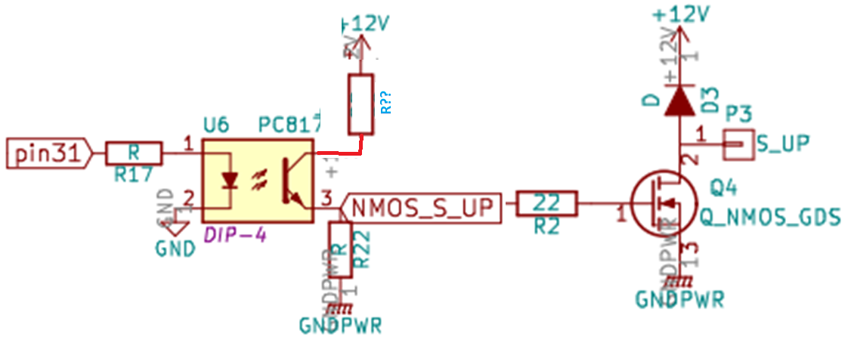
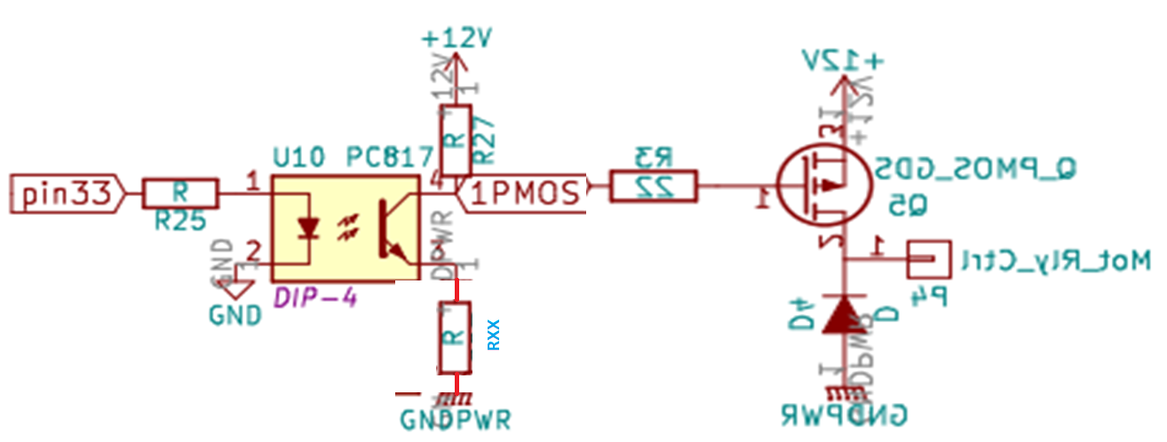
Voltage divider option for driving N mosfet.
R?? Can be shorted if not needed.
Voltage divider option for driving P mosfet.
RXX Can be shorted if not needed.

Slide 11
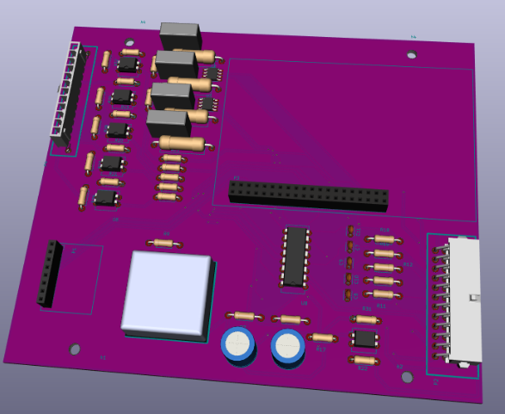
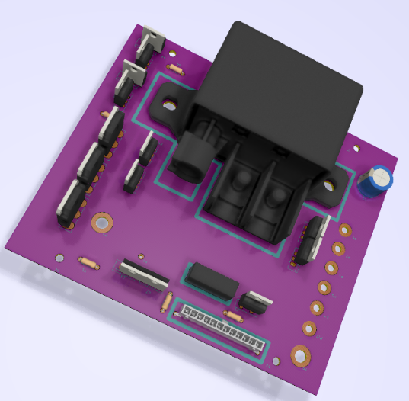
Questions and comments for Delivery vcu_v01
Can thru hole Sw_Pos be located close to motor control 3x PMOS? The current in the PCB will be battery +ve > power relay > Sw_Pos > 3x PMOS > Mot_Ctrl > motor > battery –ve. So we want the traces Sw_Pos > 3x PMOS > Mot_Ctrl as short, and as wide as possible? Can these traces also be made on both sides? Just trying to think of ways to lower the trace resistance. Any ideas would be great, like 4oz and 20mm wide.
Can the PCB_POWER capacitor (C9 in slide 2) be located near “Sw_Pos“ thru hole? This cap is for filtering the current ripple resulting from PWM control of 3x PMOM, so we want minimal resistance between it and 3s PMOS.
Can we make thru hole Sw_Pos 0.210in dia? It was 0.130
Can we make thru hole Bat_Pos 0.130in dia? It was 0.210
Can the PCB_POWER thru holes be labeled with their names as shown in slide 2 schematic?
PCB_SHIELD does not appear to have mounting holes for PI, could we add at least 2 (the 2 opposite side of PI GPIO header), preferably all 4 if space allows?
What are the DCDC in/out caps part numbers?
Will there eventually be some labeling of components and the boards? Sorry if this happens at later stage, I’m learning lots about KiCad as we go.

Slide 12
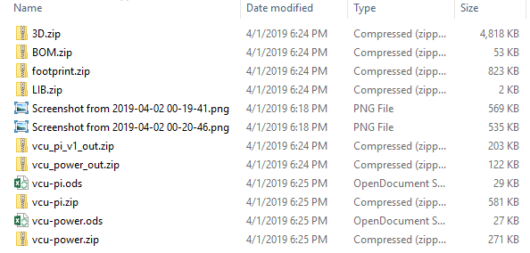
Milestone 2delivery questions
Is this showing all the files delivered? Did I miss any?

Slide 13
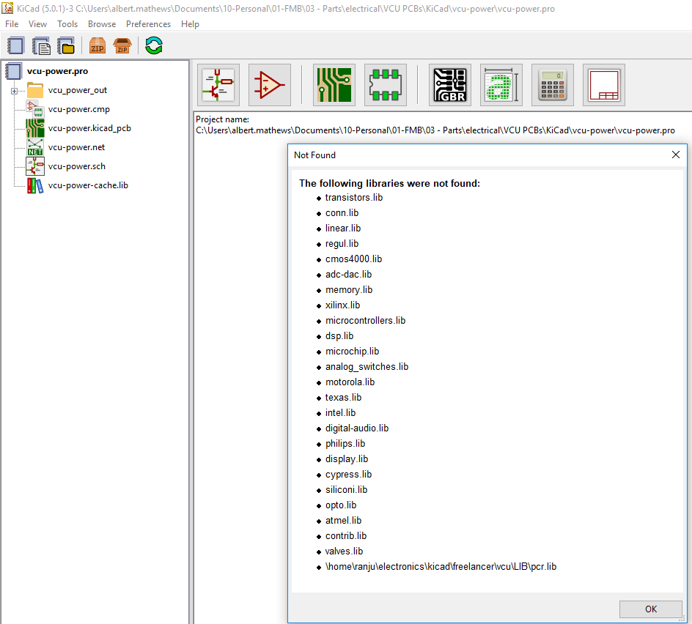
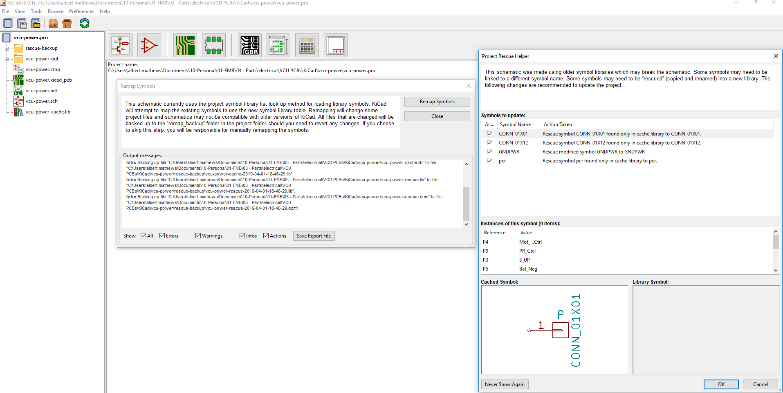
Vcu-power questions
I clicked ok, then I clicked “Remap Symbols”, then I got this error. How do I resolve this?
I tried opening vcu-power.pro, I got the following error. How can I resolve this?
I clicked ok, then I saved the report file. It here =>

Slide 14
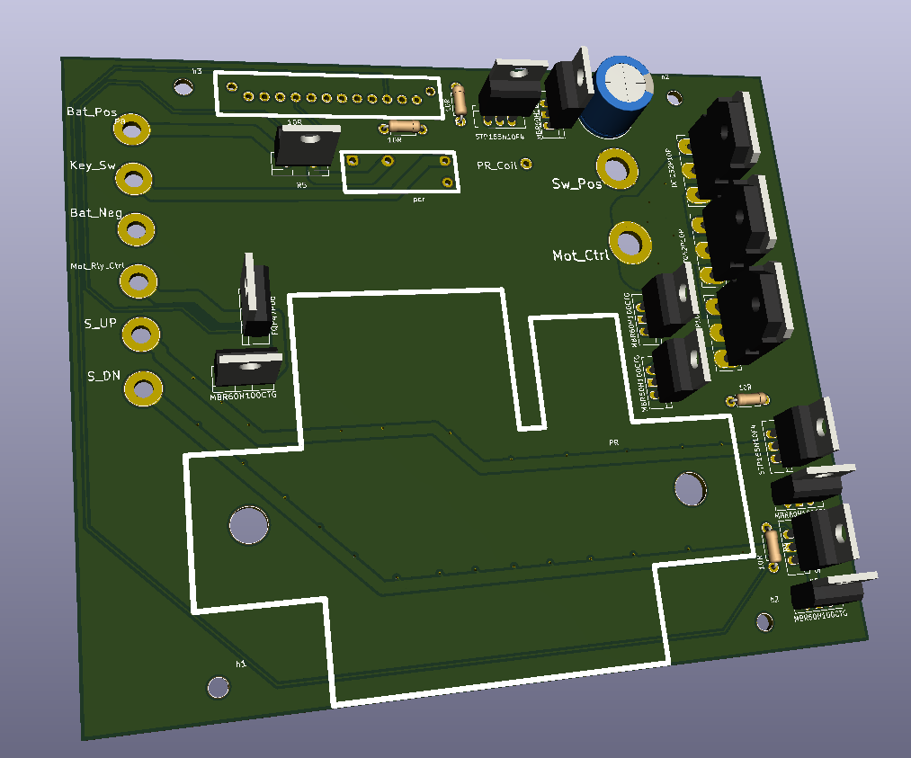
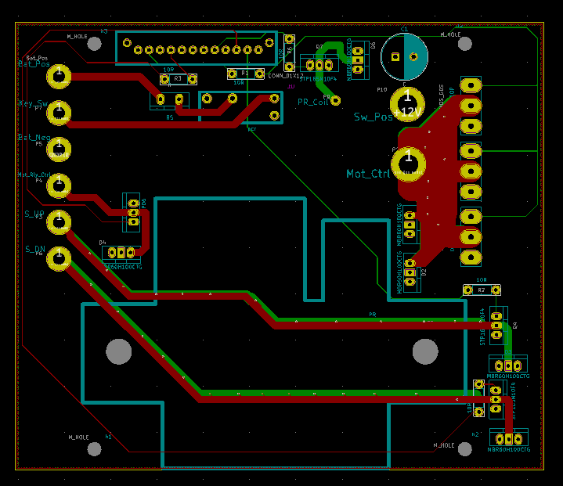
Vcu-power questions
I opened vcu-power and I see some components do not show. How do I resolve this?
Connectors/header
PR (large relay)
PCR (small relay)
In Pcbnew, I cant see the traces connecting:
Sw_Pos (the trace between Mot_Ctrl and 3x PMOS drain is perfect, why cant I see the same between Sw_Pow and 3x PMOS drain?)
C9 cap
3x PMOS drain
All GNDPWR connections?
I only see 2 layers, front and back, is that correct?
Is there any other explanation you can provide to help me understand?
How to setup directories so each .pro sees the files/folders it needs to?
Link to KiCad tutorial that is good for this project
KiCad settings you have for this project that I should have as well?
Maybe you can save your settings as config file that I can load?

Slide 15
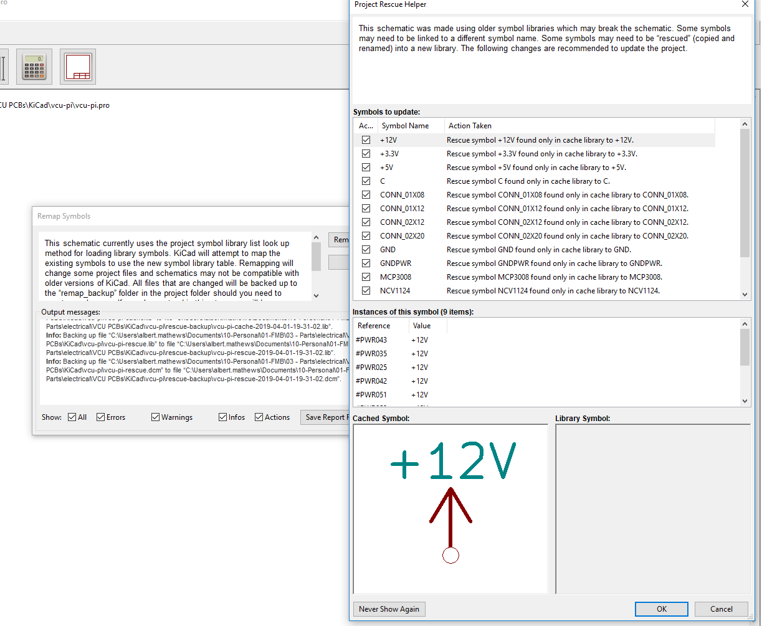
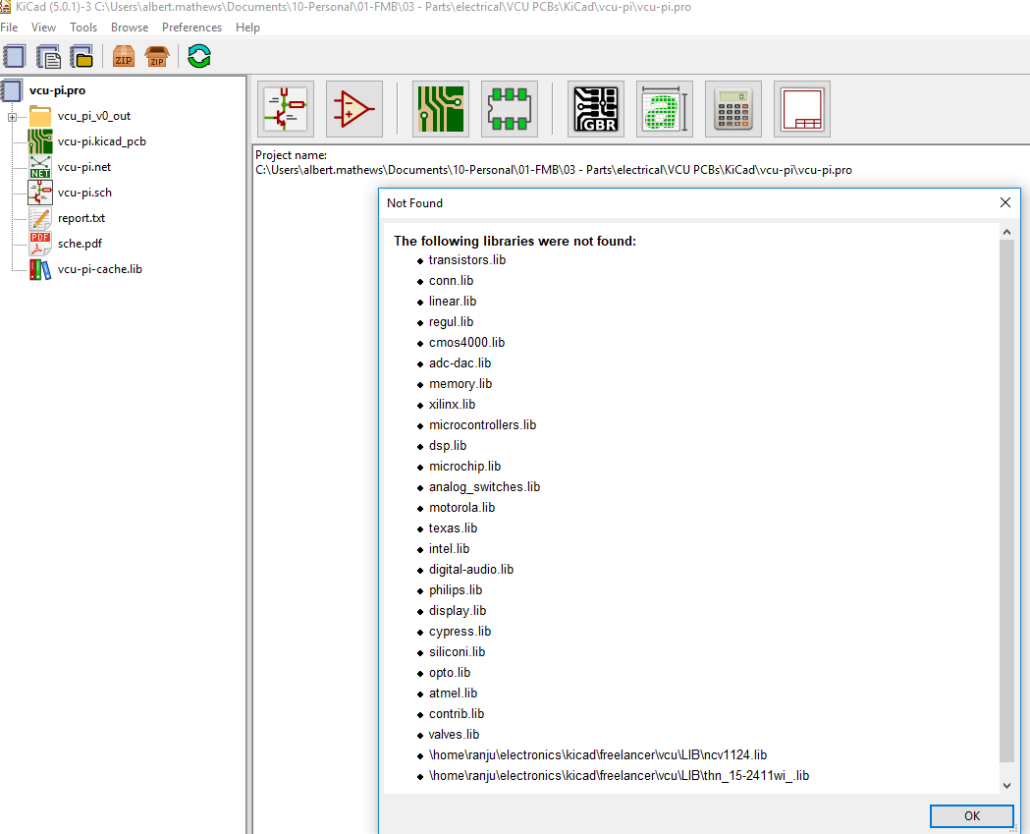
Vcu-pi questions
I clicked ok, then I clicked “Remap Symbols”, then I got this error. How do I resolve this?
I tried opening vcu-pi.pro, I got the following error. How can I resolve this?
I clicked ok, then I saved the report file. It here =>

Slide 16
Vcu-pi questions
<incomplete slide. Need to review vcu-pi KiCad files in detail.>

Slide 17
The components that showing error is due to they are not in the common library of kicad,so I made them and that files (.mod extension) are in LIB folder.
You have to use library manger to add those library to project…
You will having the same problems for the 3d objects, and footprints….(3d models having extensions as wrl or .step and they are in footprint folder)
They are located in the footprint folder…
For add 3d to footprint double click the footprint or click and press e..then a window will be pop-up on 3rd tab u will find the adding path to 3d….
And SW Pos is +12v right I made filled zone in front Cu layer with the +12v so you don’t have to worry about the current for the 3p mosfet...and also I made mosfet +12v pin as solid to pcb(normally thermal gap is there)...
And mosfet gate signals depends on the voltage not current…
Also the whole back Cu layer is ground…...(filled zone)(vcu_pi board is also like this +5v in F.Cu and GND in B.Cu
https://youtu.be/M1plXo8oLrQ
https://youtu.be/urHI1WWdr7s
And i think you don’t have to watch this all just open your schematic and file>import>footprint Association file.. select .cmp file if there is....if not i think your problem solved already...

Slide 18
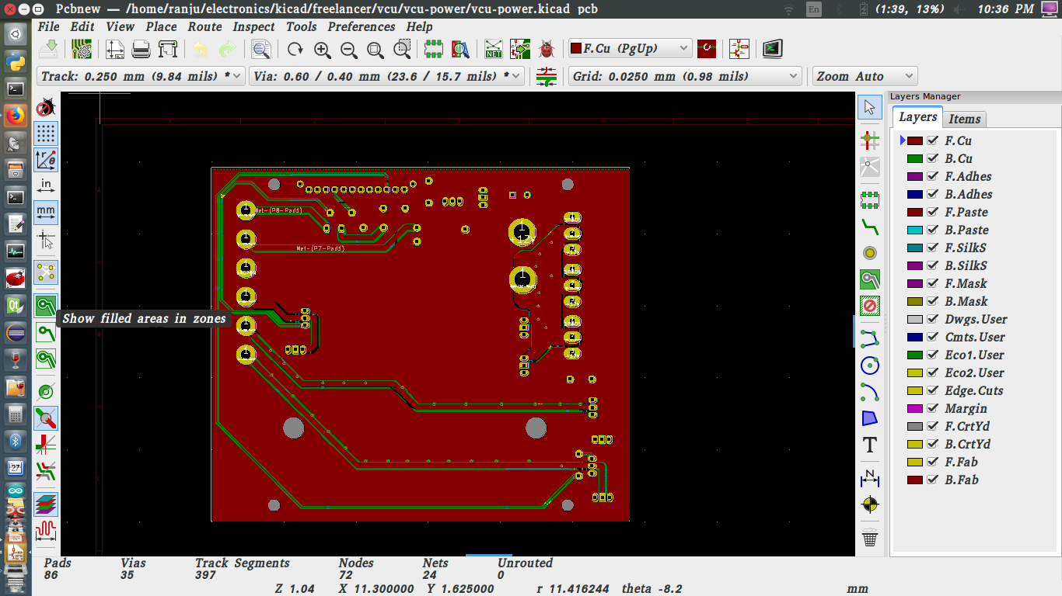
On this to view the original
view with filled zone

Slide 19
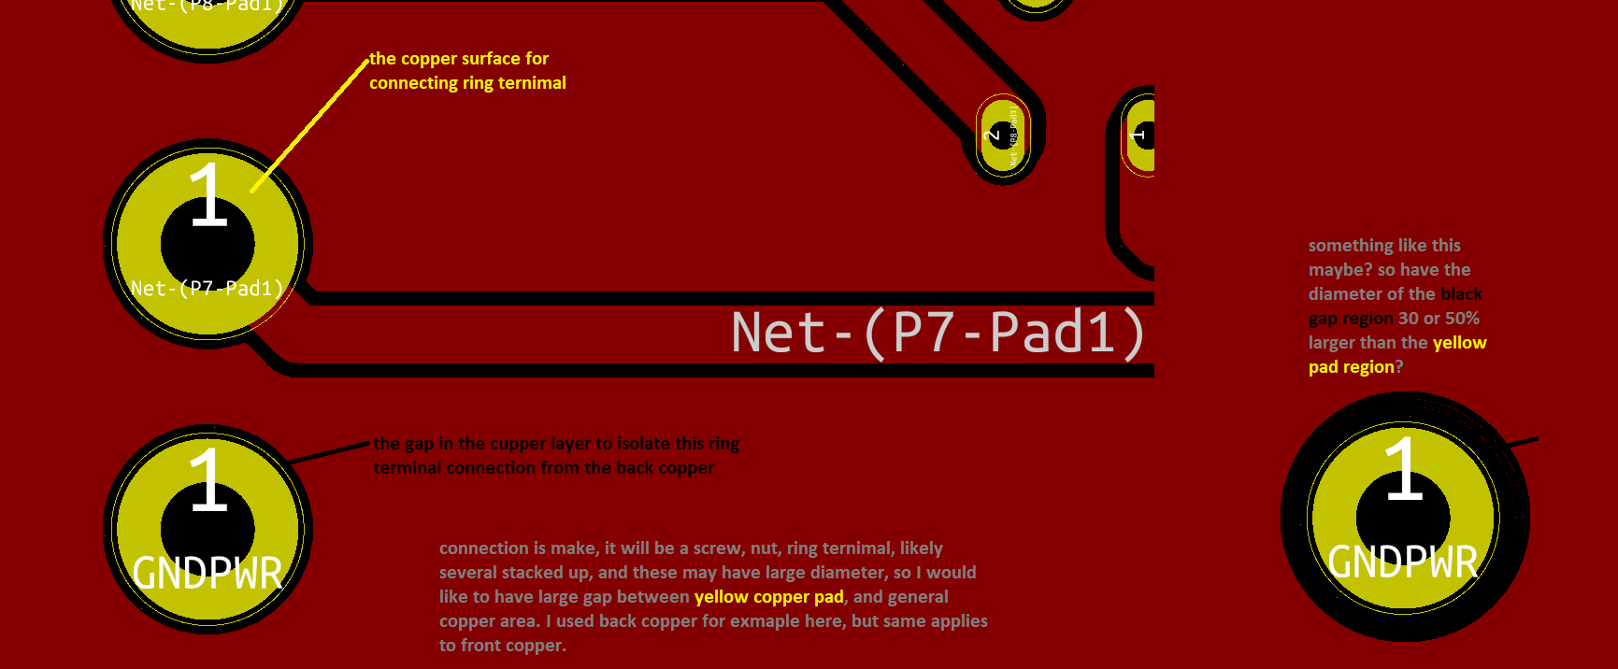

Slide 20


Why is the yellow pad only connected by 4 small traces? Why not connected around circumference? Maybe we can do something like this?
This is only needed for GNDPWR and Sw_Pos ring terminals.

Slide 21
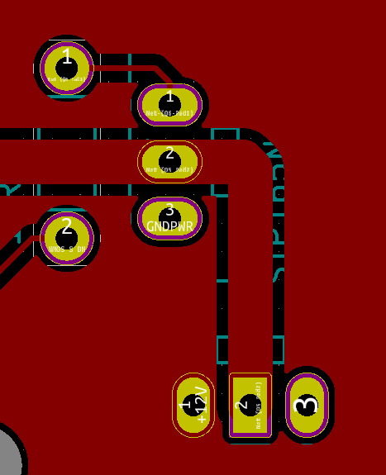
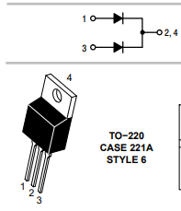
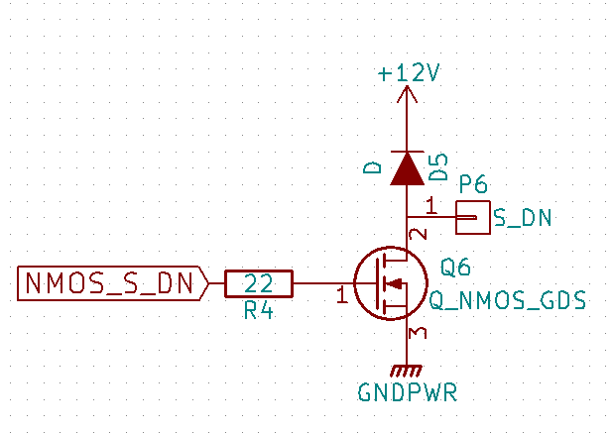
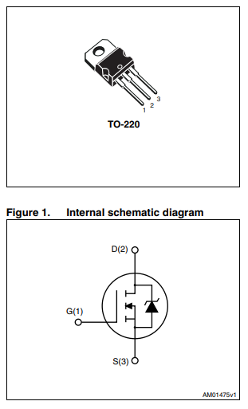
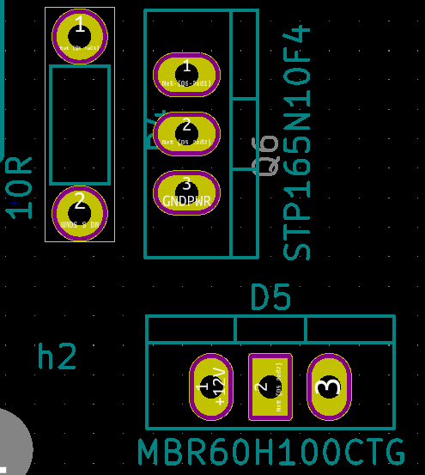
It looks like the diode D5 is connected the wrong way.
Same issue for D3 and D6
Schematic shows the connection correctly, with diode allowing flow from S_DN to +12V(Sw_Pos)
Then with copper hidden, it looks like the MBR60H100CTG footprint has +12V on pin 1, when the diode data sheet shows that +12V should be on pin 2.
D

Slide 22
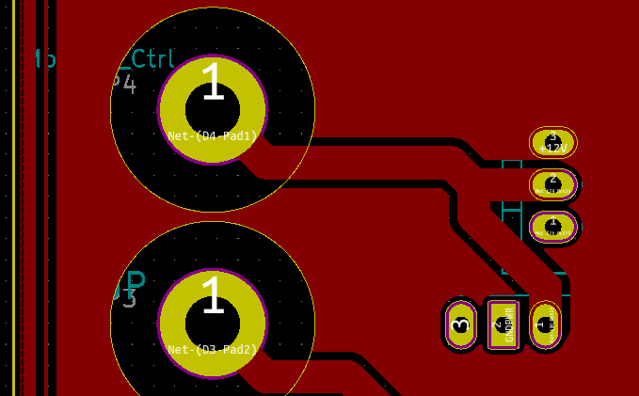
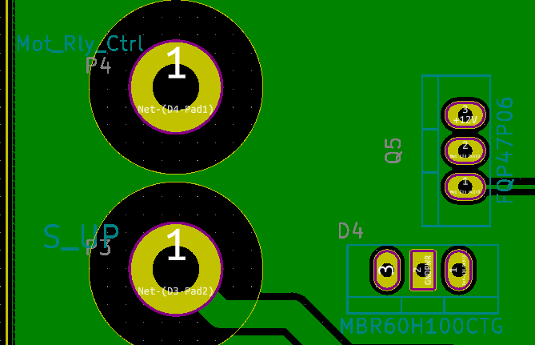
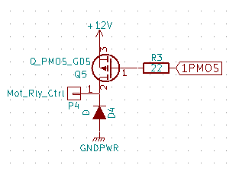
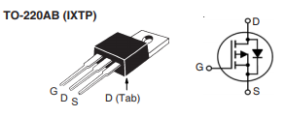
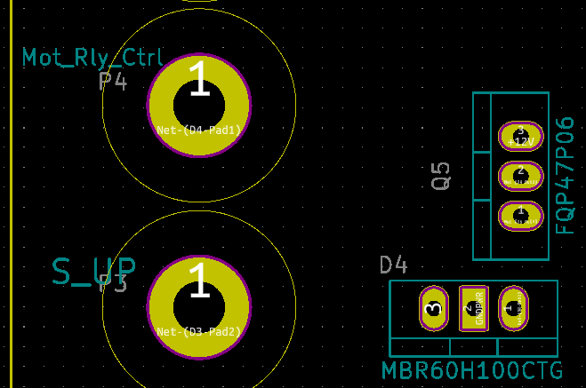
It looks like the diode D4 is connected the wrong way.
Same issue for D1 and D2
Schematic shows the connection correctly, with diode allowing flow from GNDPWR to Mot_Rly_Ctrl
Then with copper hidden, it looks like the MBR60H100CTG footprint has GNDPWR on pin 2, when the diode data sheet shows that GNDPWR should be on pin 1 or 3.
D

Slide 23
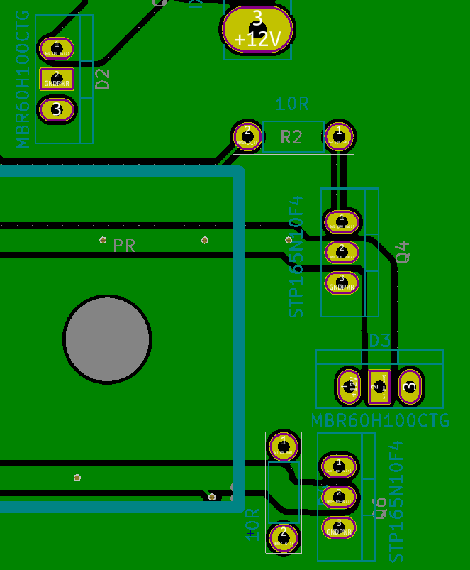
The labeling of components schematic names appears inconsistent. It would be best if all components were labeled with the schematic ID in the F.SilkS layer. Please review both boards and make labeling consistent.
I very much like the part number in the F.SilkS layer, so please keep that.
“D2” in the F.Fab layer, why not F.SilkS?
“R2” in the F.Fab layer, why not F.SilkS?
“Q4” in the F.Fab layer, why not F.SilkS?
“D5” in the F.SilkS layer, this seems like what I would expect to help debugging. Do you agree?
“R4” has no label, and the “22” in the F.Fab layer is hidden by PR outline in the F.SilkS layer.

Slide 24
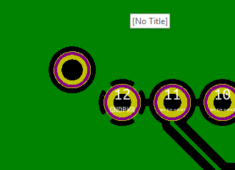
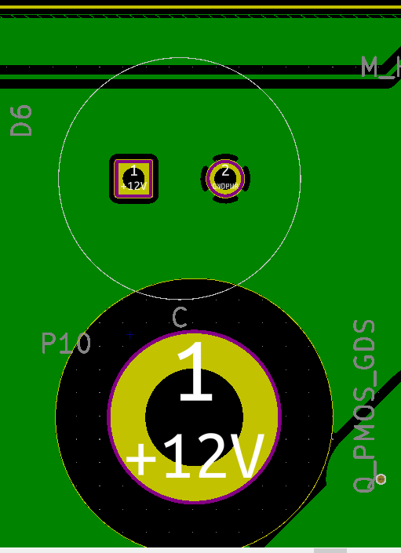
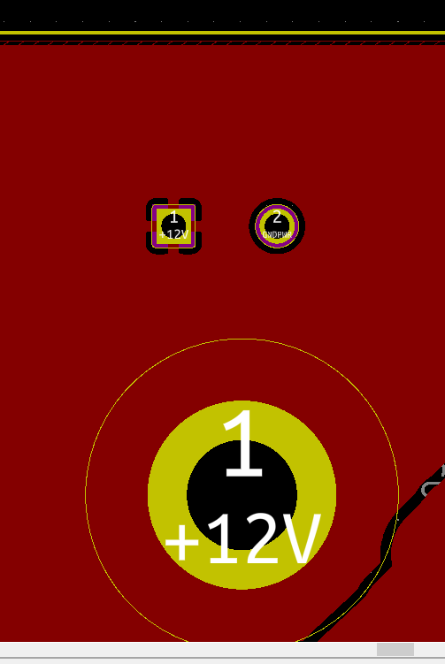
Please fill in these connection, similar to whats shown on slide 20.

Slide 25
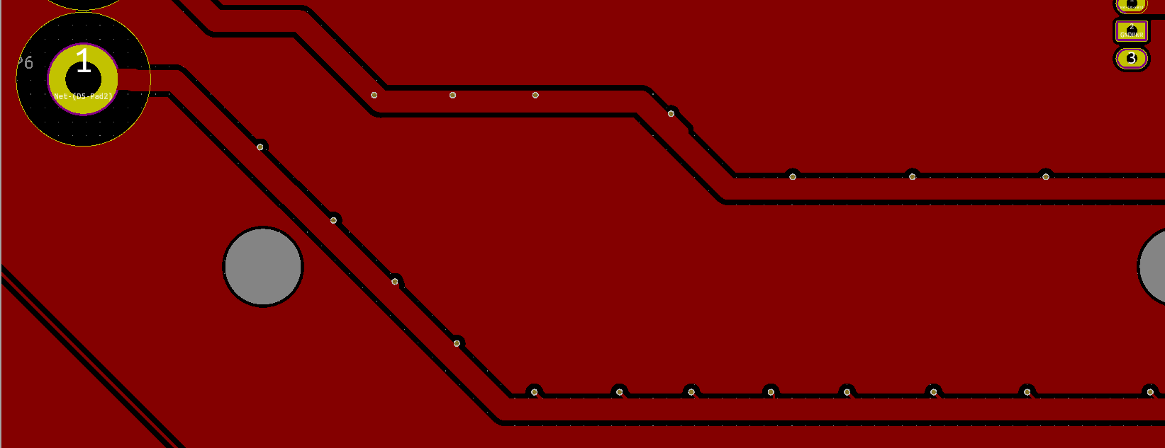
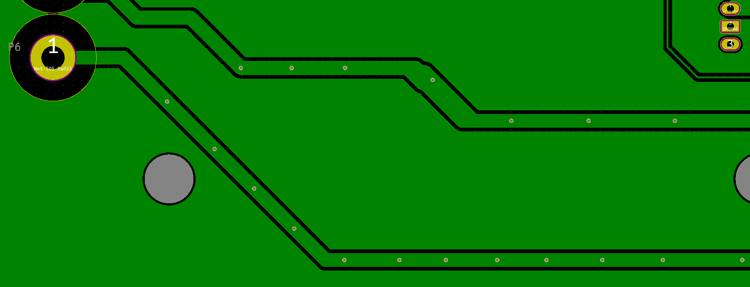
Are these small dots connections between F.Cu and B.Cu layers, so they are electrically connected along that trace, and not just connected at the trac endpoints?

Slide 26
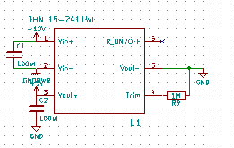



Looks like the –Vin and –Vout of the DCDC are both connected to the same node?
This is different compared to the schematic, why the common ground for 12V and 5V?

Slide 27


It looks like there is a trace that could be in contact with several connections which is not correct. To me it looks like the clearance to the F.Mask layer areas is too small.

Slide 28


PI pin check:
-
-
-
-
-
-
-
-
-
-
-
-
-
-
-
ok
-
ok
-
-
-
ok
-
-
-
-
-
-
ok
-
-
-
ok
-
ok
ok
ok
-
-
-
opto pin check:
U4=ok
U5=ok
U6
U7=ok
U9
U10=ok
None of the opto-couplers have their schematic ID (e.g. U4, U5, etc.) shown in the F.SilkS layer.
Can we show the component schematic ID in the F.SilkS layer for debugging?
Only some opto-couplers have their ID shown in the F.Fab layer.

Slide 29
https://www.pcbway.com/orderonline.aspx | 2*176=352USD for 5 of each
https://www.pcbway.com/orderonline.aspx | 2*75USD=150 for 5 of each at 2oz copper
https://www.pcbcart.com/quote | 2*199=398USD for 5 of each
http://www.goldphoenixpcb.com/pcb-special-price.html | 2*135=270USD for 2 or 3 each (worth sending gerbers)
https://www.raypcb.com/4-oz-copper-pcb/
http://dirtypcbs.com/store/pcbs | 2*58=116 USD for 10 of each with 2oz copper, no shipping.
Board specifications Board material: FR4 Board thickness: 1.57 mm Board colour: Any Silkscreen colour: white Mask colour: Any Copper thickness: 4 oz Copper layers: 2 PCB surface finish: HASL Dimensions: 145 x 122 mm
https://www.pcbway.com/orderonline.aspx | 2*176=352USD for 5 of each
https://www.pcbway.com/orderonline.aspx | 2*75USD=150 for 5 of each at 2oz copper
https://www.pcbcart.com/quote | 2*199=398USD for 5 of each
http://www.goldphoenixpcb.com/pcb-special-price.html | 2*135=270USD for 2 or 3 each (worth sending gerbers)
https://www.raypcb.com/4-oz-copper-pcb/
http://dirtypcbs.com/store/pcbs | 2*58=116 USD for 10 of each with 2oz copper, no shipping.

Slide 30





Component ID and spec value shown next to foot print, so visible when component installed
Example with resistor:
F.SilkS items missing:
Vcu-pi
U4
U7
U9
Vcu-power
R4
Still some content in F.Fab that should move to F.SilkS
C1 missing spec value. 2000uF
Component ID and part number shown next to foot print, so visible when component installed
Example with opto-coupler:
Component ID not under footprint.
Component spec value is under footprint, if not room else where.
Example using resistor.
Component ID not under footprint.
Component part number is under footprint, if not room else where.
Example using opto-coupler

Slide 31



Slide 32
Fasteners and standoffs
PI standoffs
Height=13.5+2.8=16.3mm = 0.642in
Screw dia = 2.7mm = 0.1in
Screw length vcu=0.1+nut
Screw length pi = 0.1+nut
OD = 5mm = 0.2in
Qty=4
Accelerometer
Height=2.54+8.5=11mm=0.433in
Screw dia = 2.7mm = 0.1in
OD = 5mm = 0.2in
Qty=2
Power relay
OD=0.25in
Length = 0.225+plastic washer+nut
PCB to box

